Slide 1


Hypothesis Testing Optimization:
Development of Variance Reduction Techniques
in Mobile Gaming Data
Po Yu Wang
MSc Business Analytics, Aug 2024

Slide 2
Cover Outline
Company and project overview
Techniques introduction
Result
conclusion

Slide 3

Questions to Answer
Q1. What business value has your project delivered?
Q4. Which area(s) would you have liked to explore more in this project and why didn't you?
Q5. What was the most technically challenging part of the project and why?
Q7. What would you need to do next in your project e.g. what steps need to be taken to operationalise your findings or put something into production?
Target audience: business audiences with data science background

Slide 4
Company & Project
Background

Slide 5


Company Overview
Tripledot is a UK-based mobile game studio and aims to develop great casual games for players.
Tripledot has developed 46 games and has million of users.

Slide 6

What’s the Project About?
Problem!
Tripledot relies heavily on A/B tests for product changes. However, improving A/B tests is usually time-consuming and costly.
Approach!
Develop customised variance reduction techniques to increase statistical power.
Target!
Reducing variances improves the A/B test's ability to detect existing effects, helping Tripledot make decisions more easily.
Result!
Six models were developed and evaluated. If implemented, the company can reduce up to 70% of variance in an A/B test.

Slide 7
Project Flow
Develop a variance reduction model
Query data from Snowflake
A/A test
Four potential models
Practical Implementation
Strengthen model
Six models were developed eventually
Q5. What was the most technically challenging part of the project and why?

Slide 8
Technical Background

Slide 9
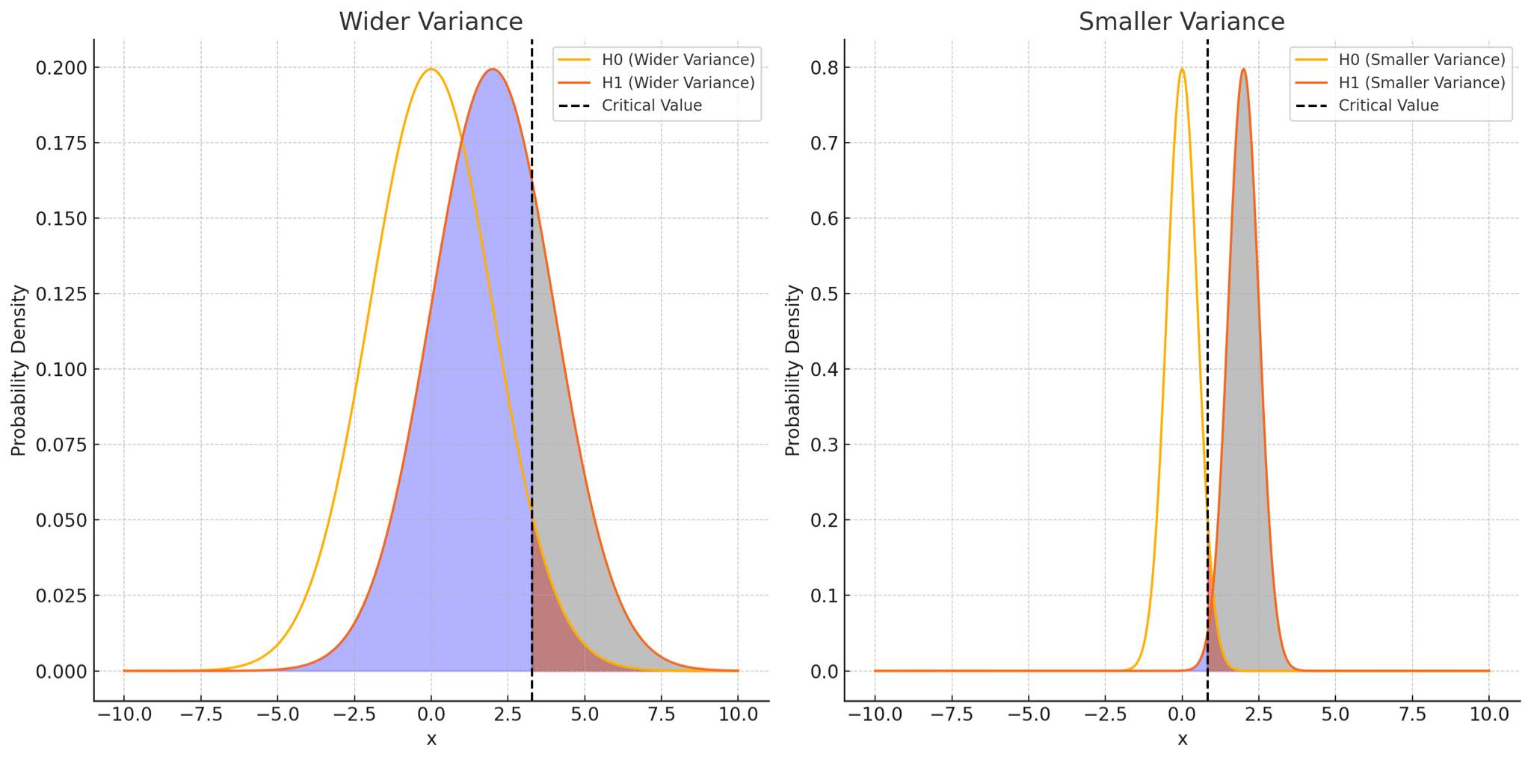
Why’s Variance Reduction Important?
Reducing variance can help increase the power of an A/B test,
allowing us to detect an existing effect more easily.
Grey area:
power
Grey area is bigger
with smaller variance
Type II
Type I
Q1. What business value has your project delivered?

Slide 10
How the Industry Reduce Variance
Controlling variates
are used to eliminate influence from other factors (not related to the A/B test) in the experiment.
CUPED &. CUPAC
Post stratification
ensures that the sample reflects the population by weighting estimators based on the population size ratio to sample size within each stratum.
Country
Num game start
Treatment effect

Slide 11
CUPED & CUPAC
CUPED
CUPAC
country
Pre-experiment
num game start
Machine learning
Pre-experiment
Num game start
Estimated
covariate
Num game start
Num game start
platform
Treatment effect
Treatment effect

Slide 12
Models and Results

Slide 13
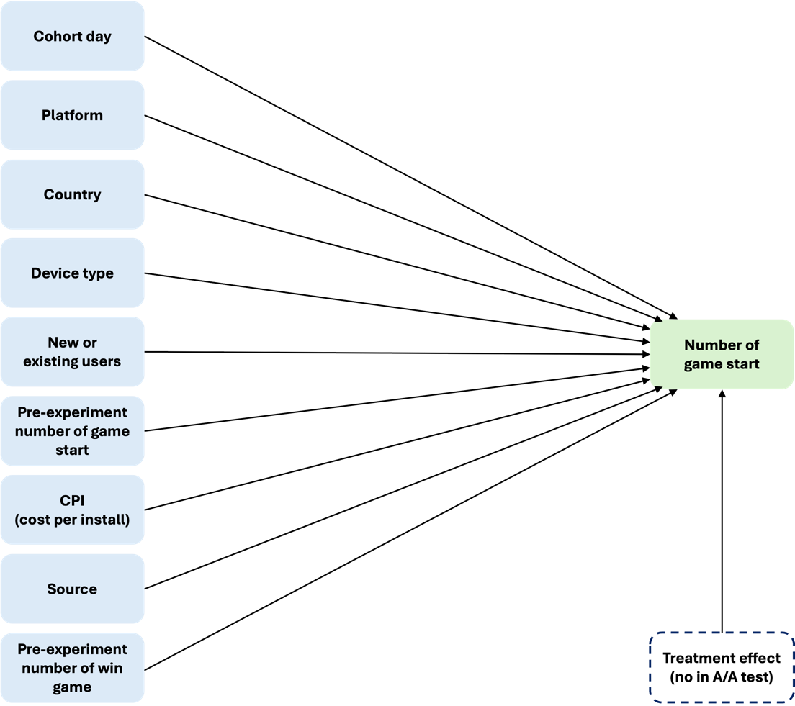
Data
Features of one dataset for A/A tests
Four datasets were queried from Tripledot’s database by SQL.
Datasets are about user activity and A/B tests.
Datasets vary due to models requiring different data.

Slide 14
6 Models Were Built
Post-stratification
CUPED
. Basic CUPED
. CUPED with machine learning, which can handle missing values of pre-experiment data
CUPAC
. CUPAC without pre-experiment data
. CUPAC with pre-experiment data
. CUPAC with feature selection

Slide 15
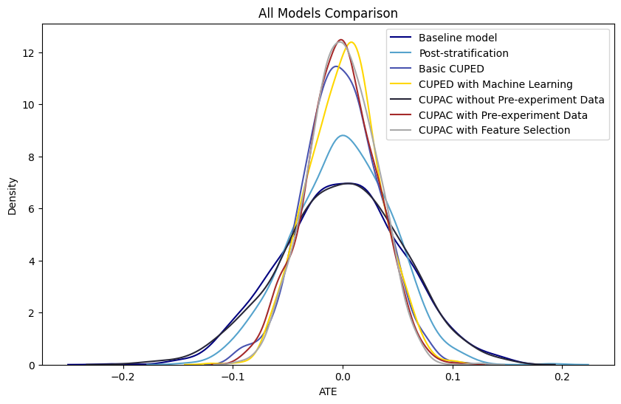
A/A Test Results
v
v
Reduce most variance
CUPAC with feature selection 68.7%
CUPAC with pre-experiment data 65.3%
CUPED with ML 65.4%
CUPED 61.5%
BUT CUPED with ML caused bias!
v
v

Slide 16
A/A Test results
 | Variance | Variance Reduction Percentage Comparing to the Baseline Model | Mean | Mean Diff Comparing to the Baseline Model
Baseline | 0.002997 | 0.0% | -0.000953 | 0.0%
Post- stratification | 0.001997 | 33.372574% | -0.000463 | 51.373255%
Basic CUPED | 0.001154 | 61.480803% | - 0.001225 | -28.546257%
CUPED with ML | 0.001037 | 65.405063% | 0.000850 | 189.143956%
CUPAC without pre-experiment data | 0.003043 | -1.542138% | - 0.000866 | 9.115101%
CUPAC with pre-experiment data | 0.001041 | 65.271019% | -0.002028 | -112.778525%
CUPAC with feature selection | 0.000938 | 68.693642% | -0.000470 | 50.700868%
The information contained in this document is confidential and may not be used, published or redistributed without the prior written consent of Tripledot Studios Ltd.

Slide 17
Implementation on an All-user A/B test
*The proportion of having pre-experiment data: 0.821
Overall, CUPAC with feature selection performed the best.
CUPED performed slightly worse but still impactful.
 | P-value | Treatment Variance | Treatment Variance Reduction Comparing to the Baseline Model | Effect Size
Baseline | 0.384538 | 4217.5674 | 0.0% | 0.065210
Basic CUPED | 0.046055 | 1394.5660 | 66.934351% | 0.214753
CUPED with ML | 0.084862 | 1216.1989 | 71.163496% | 0.163962
CUPAC with pre-experiment data | 0.045515 | 1164.8754 | 72.380396% | 0.201657
CUPAC with feature selection | 0.038852 | 1101.4462 | 73.884323% | 0.194400

Slide 18
Implementation on a New-user A/B test
*The proportion of having pre-experiment data: 0.017
Overall, all modes were limited due to the lack of pre-experiment data.
CUPAC with feature selection still performed the best.
CUPED barely had impact.
 | P-value | Treatment Variance | Treatment Variance Reduction Comparing to the Baseline Model | Effect Size
Baseline | 0.735250 | 1662.063535 | 0.0% | -0.065031
Basic CUPED | 0.739621 | 1659.534360 | 0.152170% | -0.066366
CUPED with ML | 0.679488 | 1356.940694 | 18.358073% | -0.043448
CUPAC with pre-experiment data | 0.653971 | 1592.617736 | 4.178287% | -0.040077
CUPAC with feature selection | 0.590676 | 1494.066969 | 10.107710% | -0.022469

Slide 19
Business Recommendations
Technically: CUPAC with feature selection performed best in the A/A test and practical test.
In Practical: CUPED is powerful enough because
CUPED only performed slightly worse than CUPAC, roughly reduced 10% less of variances
Developing CUPAC is costly for resources
Steps to launch CUPED: build data pipeline with data engineers, develop UI
In Future: CUPAC can still be an option because
Handle new-user test better
More potential. The model can be improved easily by choosing the correct variables.
Q4. Which area(s) would you have liked to explore more in this project and why didn't you?
Q7. What would you need to do next in your project e.g. what steps need to be taken to operationalise your findings or put something into production?

Slide 20
Thank you!

